Slide 1
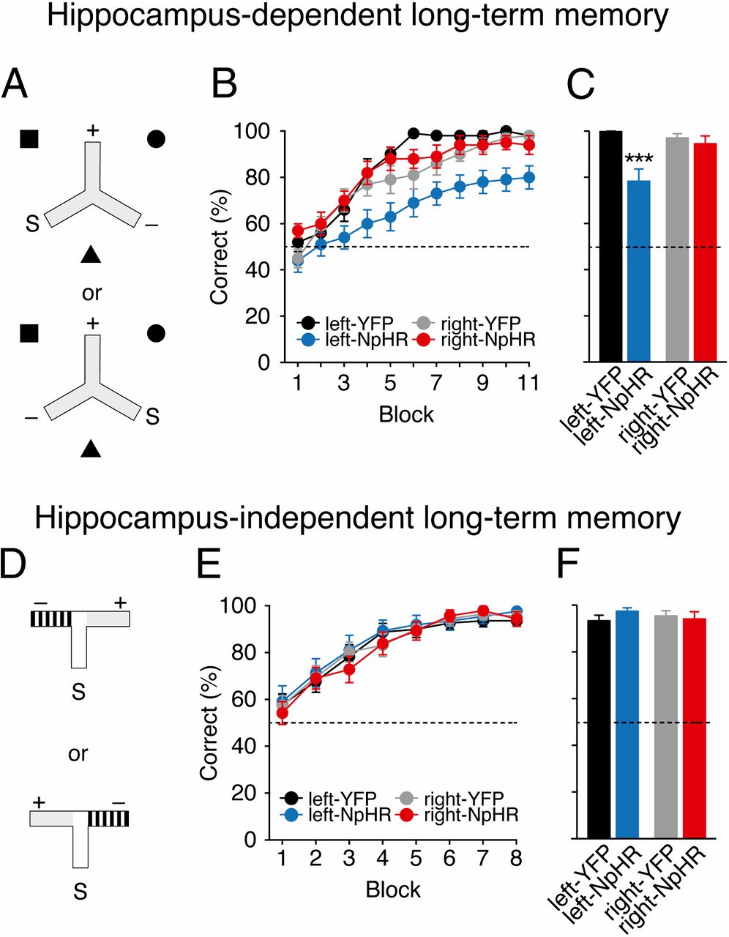

Hippocampus-dependent associative spatial long-term memory uniquely requires the left CA3.
Olivia A. Shipton et al. PNAS 2014;111:42:15238-15243
©2014 by National Academy of Sciences
Notes:
Hippocampus-dependent associative spatial long-term memory uniquely requires the left CA3. (A) Mice were trained on a hippocampus-dependent long-term memory task where they had to associate a reward location that was fixed with respect to allocentric extramaze spatial cues (black square, circle, and triangle), and remained constant for each mouse across consecutive days of testing. Mice received arm starts (S) to the left or the right of the rewarded arm (+) in a pseudorandom order. Mice entering the nonrewarded arm (−) were not allowed to self-correct. (B) Light delivery in mice expressing eNpHR3.0 in the left CA3 (left-NpHR, blue) impairs but does not affect learning in right-NpHR mice (red) and control groups (left-YFP: black, right-YFP: gray) in this hippocampus-dependent long-term memory task. (C) Average performance on penultimate day. (D) Mice were trained on a hippocampus-independent visual-discrimination long-term memory task where they had to associate arm floor and wall color (gray vs. black-and-white stripes) with a reward; this was fixed for each mouse across consecutive days of testing. Rewarded (+) and nonrewarded (−) arms were pseudorandomly interchanged so that reward location was learnt independent of the spatial position of the arms of the maze. (E) Mice in all groups successfully learned this task at an equivalent rate. (F) Average performance on penultimate day. In both tasks, on the last day of testing, reward was delivered after the animal had chosen to control for the possibility of mice smelling the milk (postchoice baiting). Broken lines represent chance performance. Mean percentage correct choices ± SEM. ***P < 0.001.

